Slide 1
Multimodal Gait Authentication
Immobile Computing 2020
April Wang, Ausar Mundra, Ted Kim

Slide 2
background and motivation
biometrics
use of an individual’s unique physical or behavioural characteristics as a means to identify or authenticate
e.g., fingerprint, facial features, keystroke patterns, gait
Notes:
Biometrics
mobile biometrics and gait
multi-modal gait authentication for mobile/wearable biometrics

Slide 3
background and motivation
biometrics
use of an individual’s unique physical or behavioural characteristics as a means to identify or authenticate
e.g., fingerprint, facial features, keystroke patterns, gait
gait analysis
analysis of individuals’ unique walking patterns typically via computer vision, floor sensors, or wearable sensors (i.e., accelerometer)
Notes:
Biometrics
mobile biometrics and gait
multi-modal gait authentication for mobile/wearable biometrics

Slide 4
background and motivation
biometrics
use of an individual’s unique physical or behavioural characteristics as a means to identify or authenticate
e.g., fingerprint, facial features, keystroke patterns, gait
gait analysis
analysis of individuals’ unique walking patterns typically via computer vision, floor sensors, or wearable sensors (i.e., accelerometer)
Our approach: multi-modal gait authentication
user’s device as wearable sensor
external camera for vision analysis
use both to featurize individual gait patterns
authenticate - accept or reject
Notes:
Biometrics
mobile biometrics and gait
multi-modal gait authentication for mobile/wearable biometrics

Slide 5
contribution: multi-modal gait authentication
more robust to spoofing: more secure
multimodal: (hopefully) greater accuracy
unobtrusive and does not require direct user interaction: eyes-free

Slide 6
system architecture
Sensing
Computing & Classification
Webcam
USB/Direct Connection to Server
Server (Laptop/Desktop)
Mobile Device (iphone)
HTTPS (POST) w/ accelerometer data in CSV
Computation and classification of video and mobile data is done on the server with numpy and torch

Slide 7
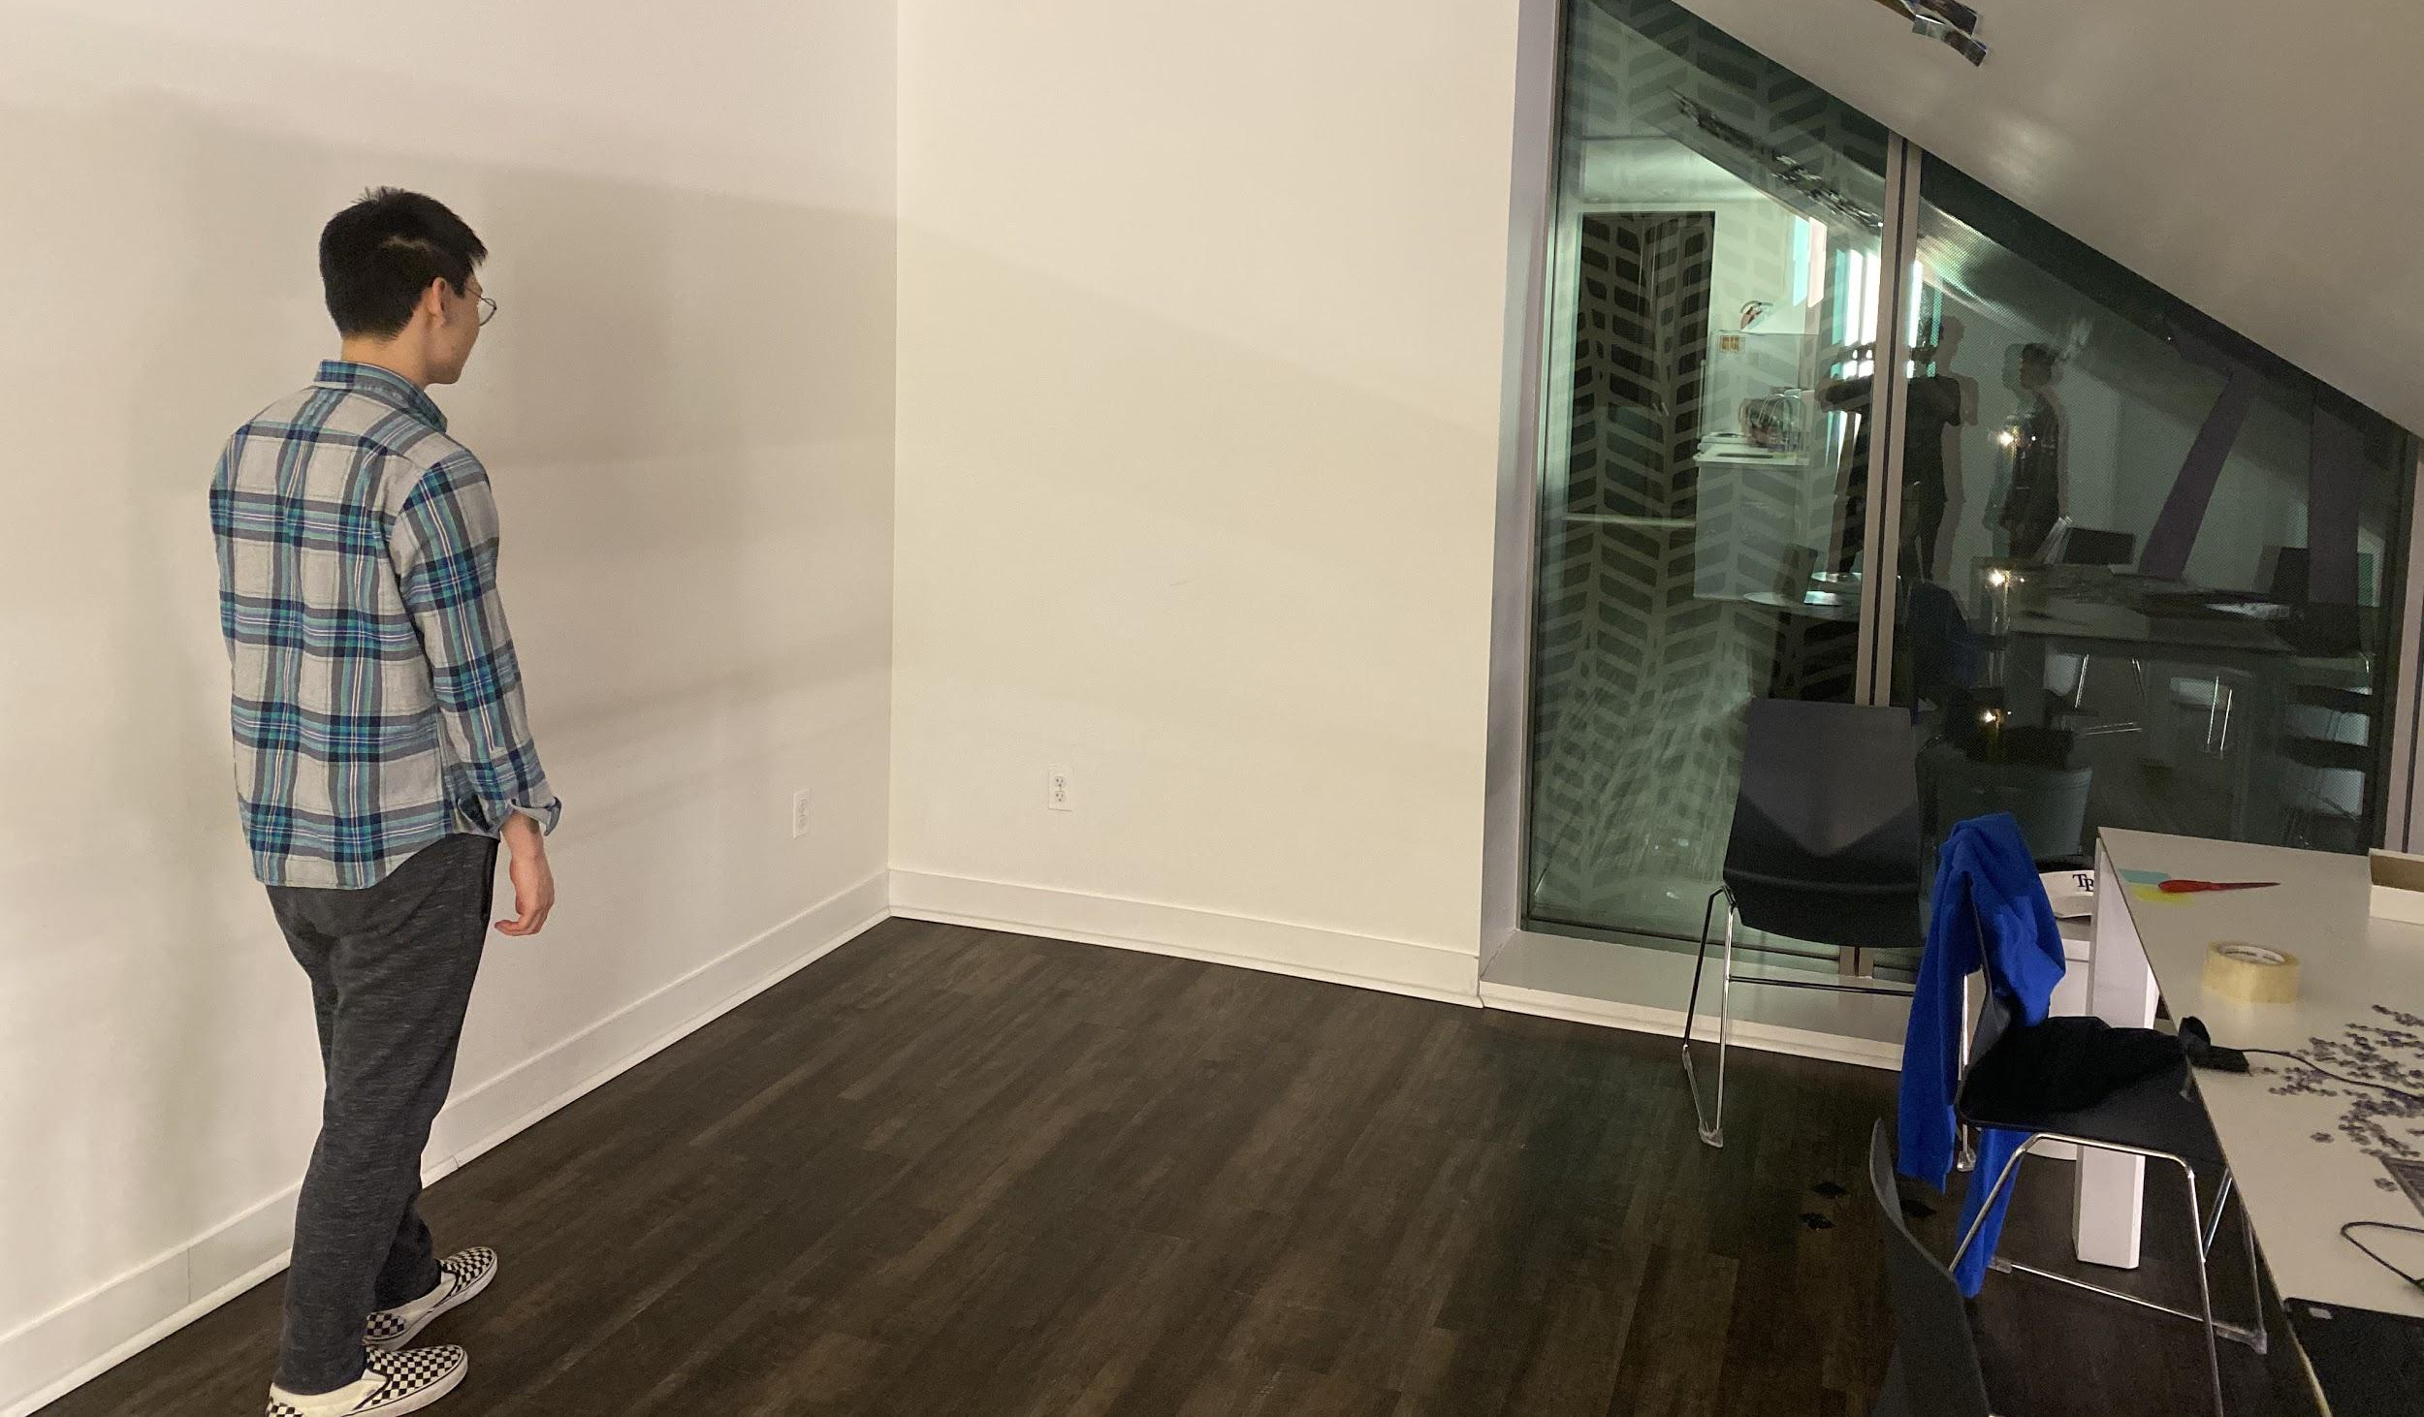
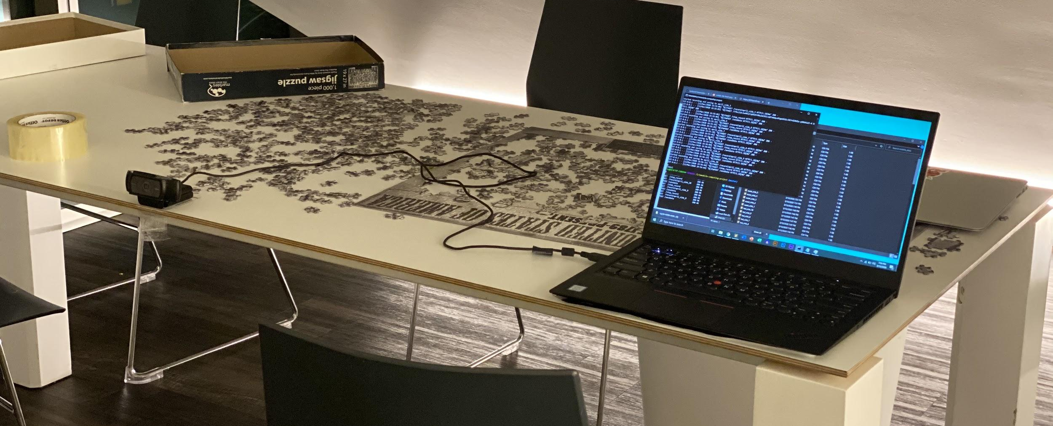
experimental setup
User with Phone
Webcam
Computer connected to webcam,
receiving app data through ngrok

Slide 8
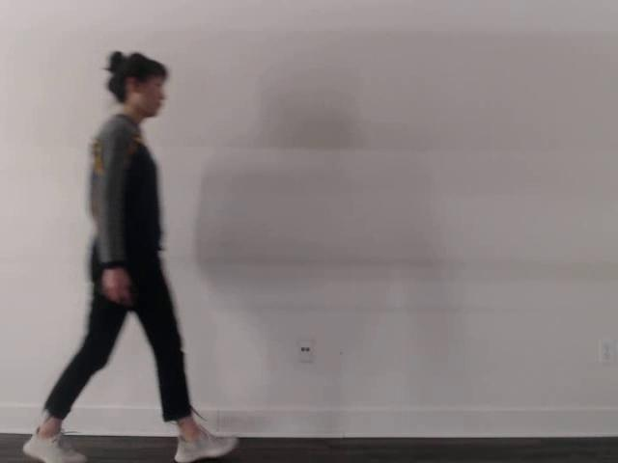
video demo

Slide 9
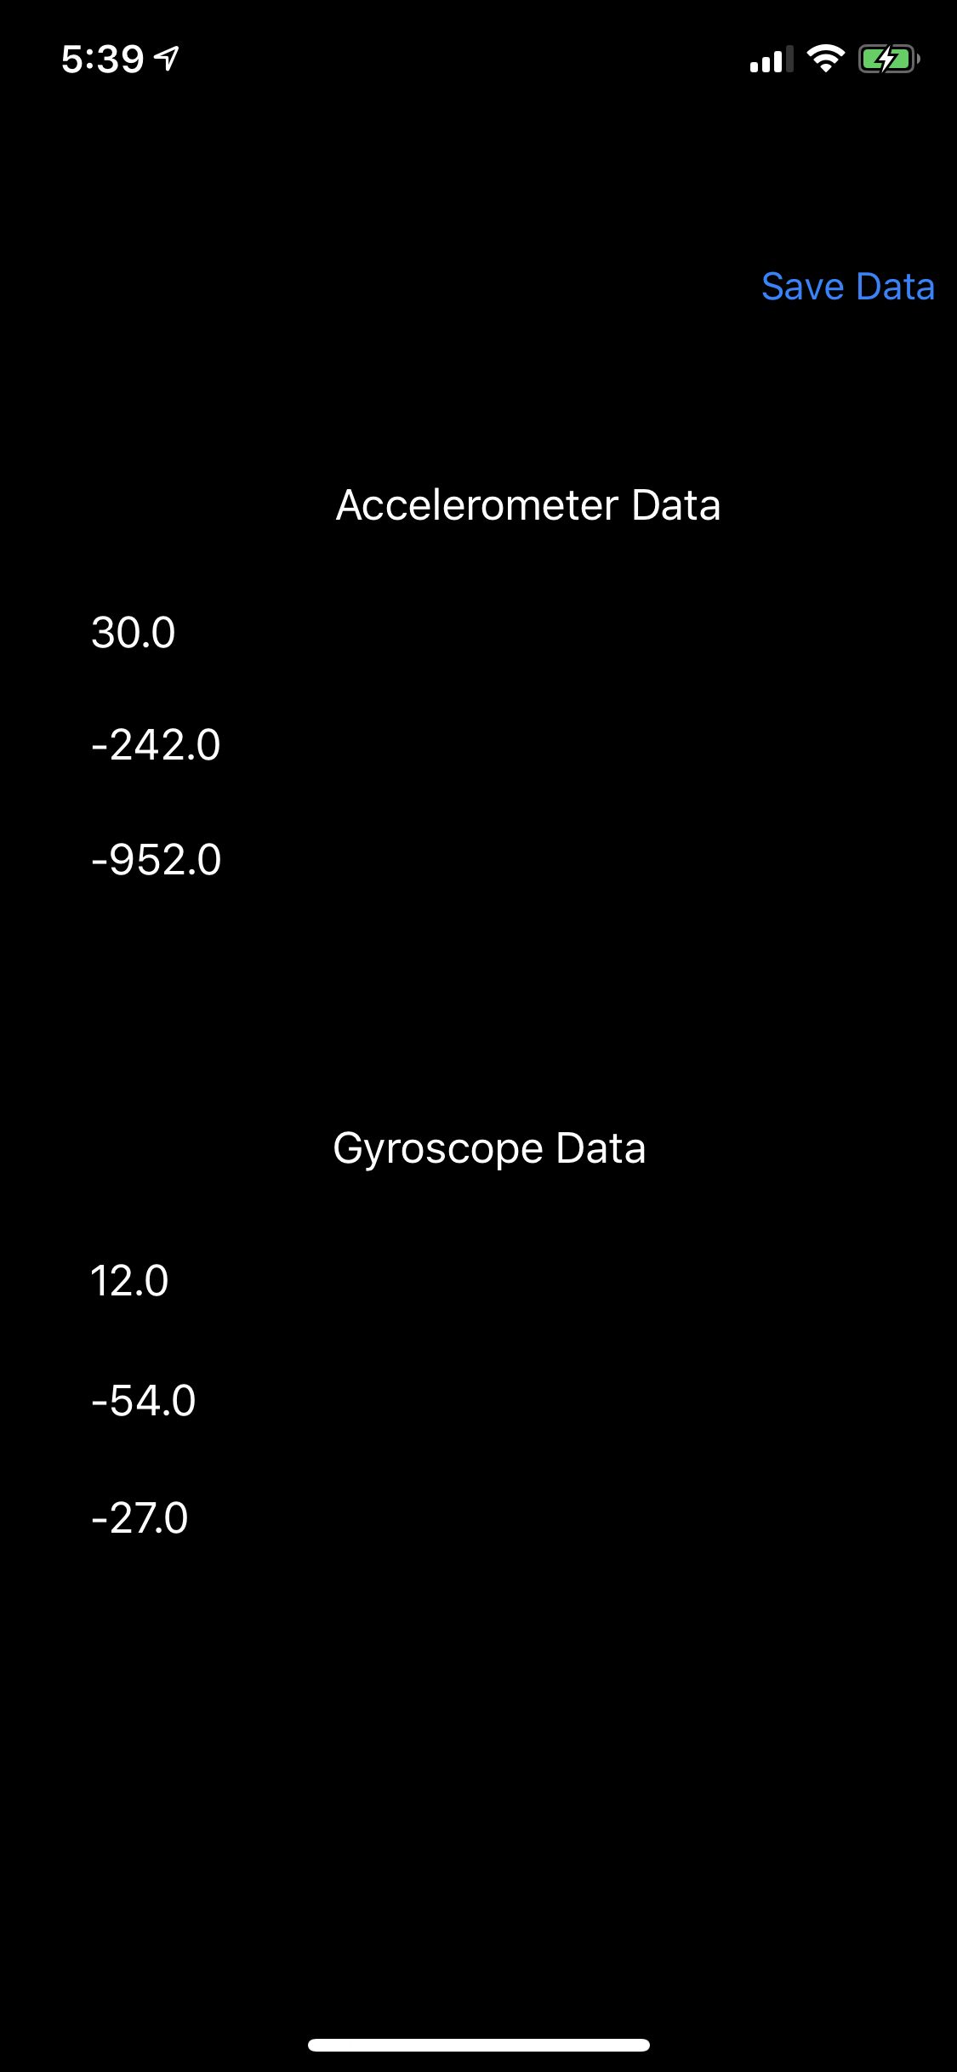
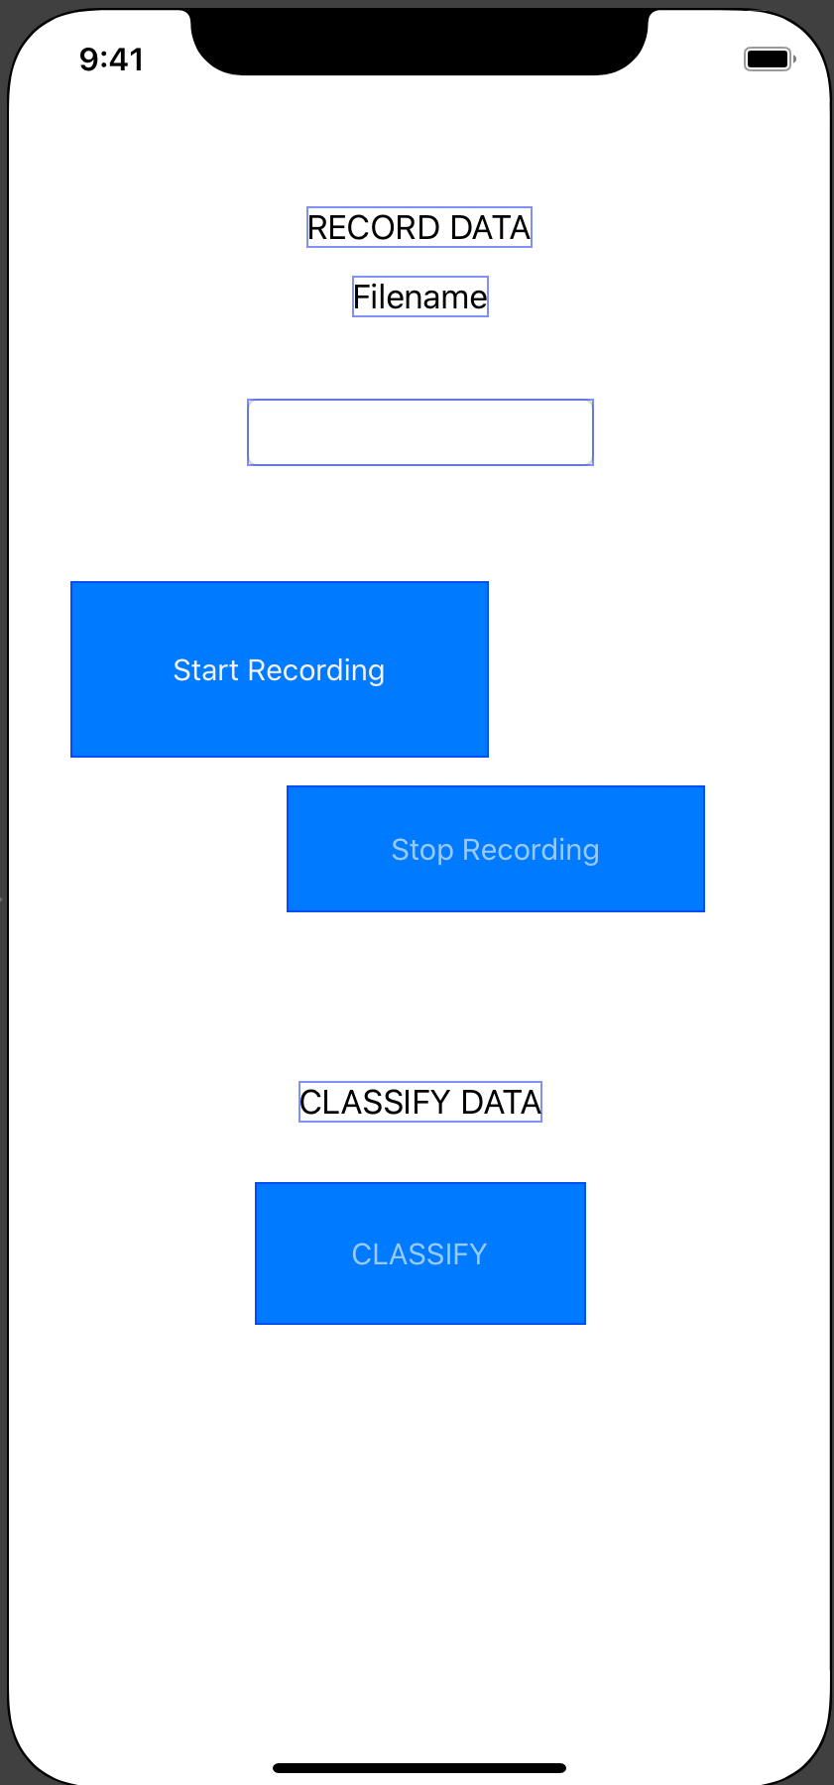
app functionality and design
iOS app records accelerometer and gyroscope data
The same application records data and classifies/detects user and streamlines data collecting for the classification pipeline
Utilizes HTTPS GET requests to contact server and start webcam (GET), POST requests to send accelerometer data as a CSV and signals to stop recording
By using GET/POST requests to remote server and send data, we reduce phone power usage to process accelerometer and video data
App Version 1
Final App Version

Slide 10
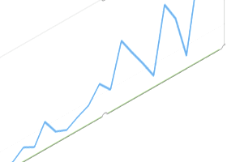
gait classification: a convolutional approach
Extracting simple features such as the mean or std are not descriptive enough to robustly classify users
In order to better classify users, we need to use the whole trace in order to calculate some unique feature vector
Our accelerometer data is essentially a time series with 3 dimensions, values with X, Y, Z
These values can be reimagined as an “image” with height T (time) and width M (number of variables)
2
6
0
1
0
0
1
3
4
2
0
6

Slide 11
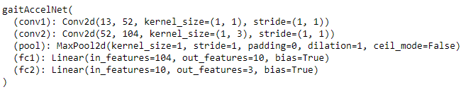
gait classification: a convolutional approach
Convolutions were used because they have similar operations to CV techniques and some research suggests that CNN’s are effective for identifying gait classification
Our GaitNet consists of 2 convolutional layers, 1 maxpool layer, and 2 fully-connected layer

Slide 12
gait classification: visual data
Pretrained model takes raw RGB video frames as input and outputs an identification vector that is linearly separable from those of other people
Two subnetworks, HumanPoseNN and GaitNN, translate spatial features to pose descriptors. Temporal features are extracted across pose descriptors via a RNN, then aggregated with average temporal pooling into a 1-d identification vector
SVM classifier identifies the individual by gait
GitHub source: https://github.com/marian-margeta/gait-recognition

Slide 13
overview of data collection
Both visual and sensor data were collected once the user pressed “start” on the app and the server receives the requests
We had 30 traces for each member for a total of 90 traces
Having 2-3 non-members traces would be ideal, allowing us to more accurately assess the performance of our classifiers
Training and validating models was done in a 80/20 split

Slide 14
possible authentication schemes
accelerometer/mobile only
visual only
accelerometer & visual combination via feature concatenation and classification
accelerometer and visual consensus: if both mobile and visual gait classifiers return “A” , that will count as an encryption

Slide 15
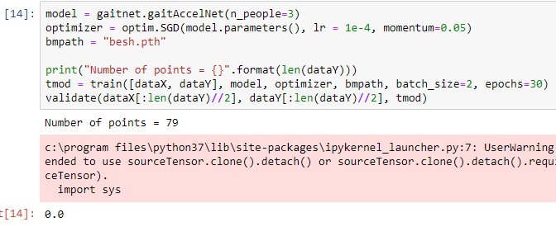
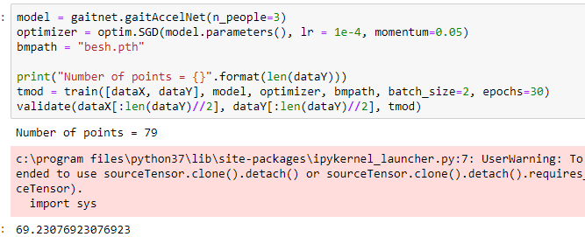
classification accuracies
Accelerometer only
averages around 34% (i.e no better than random)
some validation runs will have 0% (implies potential discriminative ability) to 70% accuracy (implies a well behaved classifier)
Visual Only
W.I.P

Slide 16
classification accuracies
Accelerometer & Visual Combined
Concatenating the feature vectors of both the
Accelerometer and Visual (Consensus Mechanism)
If both mobile and visual gait classifiers return “A” - that will count as an encryption

Slide 17
discussion and future work
collect data from more individuals to make classification more sophisticated than simply 3 category multi-class
calculate false positive and false negative rates with more individuals
explore other ways of training out system
improve classification methods by taking longer walks or including gyroscope data (had been omitted because other research has shown that gyroscopes aren’t as informative as accelerometers)

Slide 18
Additional Sources/Citations
http://homepages.inf.ed.ac.uk/mmarina/papers/ubicomp18.pdf
https://icml.cc/2011/papers/399_icmlpaper.pdf
https://pdfs.semanticscholar.org/456f/85fb61fa5f137431e6d12c5fc73cc2ebaced.pdf
https://link.springer.com/content/pdf/10.1155/2008/265767.pdf
https://www.researchgate.net/profile/Davrondzhon_Gafurov/publication/228577046_A_survey_of_biometric_gait_recognition_Approaches_security_and_challenges/links/00b49528e834aa68eb000000/A-survey-of-biometric-gait-recognition-Approaches-security-and-challenges.pdf
Deep Learning Based Gait Recognition Using Smartphones in the Wild
Notes:
https://icml.cc/2011/papers/399_icmlpaper.pdf - multi modal deep learning
https://link.springer.com/content/pdf/10.1155/2008/265767.pdf - multimodal biometric authentication

